Slide 1
Revised lectures of Drawing BY Noureen Rashid lecturer
Foundation year
2020

Slide 2
Assignment1 introduction of human figure
Please consult the attached book
“Part 1: Figure Drawing Basics—Action & Structure”

Slide 4
Assignment 2 Study of Head-Torso
Please consult the attached book
“Drawing the Human Head”
Page no 19 to 27
Page no 31 to 35
Page 38 to39
Page no 52 to 65
Page no 13 to 14

Slide 6
Assignment 3 Study of Arm to Hand-Leg to Feet
Please consult the attached book
“Dynamic Figure Drawing”
“Drawing Dynamic Hands”
Form and structure page 11 to 20
Proportions and measurement page 26 to 38
complete chapter of “The definitive body forms”

Slide 7
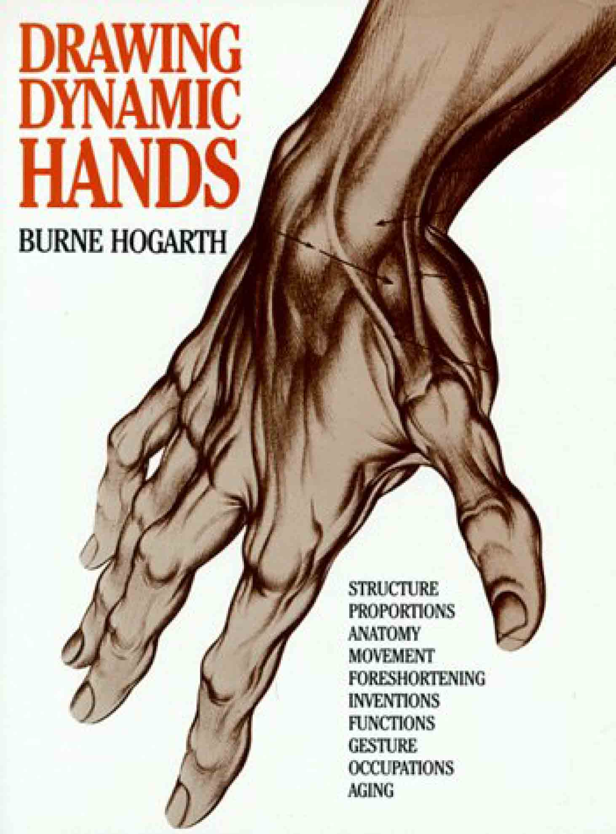

Slide 8
Assignment 4 The Study of Seated Figure
Some significant examples are given below

